Slide 1
Baller Index
Player Exchange
TEAM STAR

Slide 2
Problem Statement
Sports is an activity involving physical exertion and skill in which an individual or team competes against one or the other. It induces adrenaline in the bloodstream of not only players but also the viewers and supporters. Often, we lose contact with reality and immerse ourselves deeply in the nail-biting action and entertainment.
The huge salaries of professional athletes are, unfortunately, the fault of countless fans who are willing to put their lives on hold and pour large amounts of money into tickets, Pay-Per-View rentals, sports memorabilia, gear, and other team-related merchandise. America’s sports industry is worth a whopping $422 billion, employing 1 percent of the population with almost 3 million sports-related jobs. Fans go insane when it comes to collecting sports memorabilia and attending games, and both are only becoming more expensive, but fans aren’t becoming any less interested. Both the demand and the reckless enthusiasm to buy tickets at any cost are reasons for this needless inflation, and those printing price tags know this well enough to continue pumping money out of the herd of sports enthusiasts who are willing to dole it out.

Slide 3
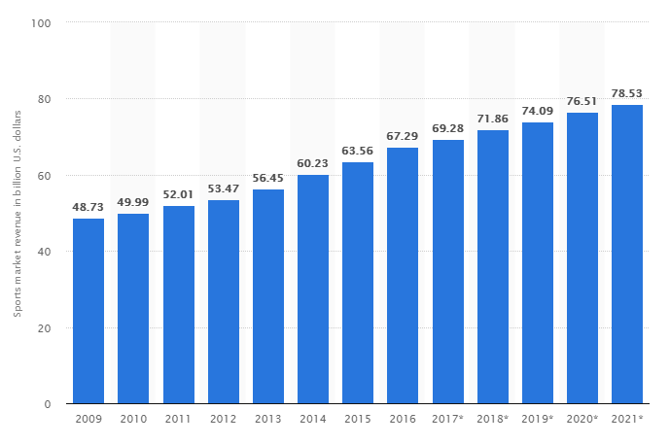
North America sports market revenue in Billion U.S dollars

Slide 4
INTRODUCTION
Now, what if I told you that you can make money watching sports. The fans make sports great and its the fans who are being looted by this enormous industry. It is our turn to exploit this industry that we fans built together.
We have built a database management system which allows you to invest in the stock of players. Each player will be given a preset value based on his career averages and current real-time form.
The prices of the players are subject to dynamic pricing and will be updated on a daily basis, if the player performs better than his career averages we will see a bump in his initial preset price, likewise his price will drop in case he performs below his career averages. We have developed a mathematical algorithm which increases the stock of the players accurately with improvement in form and averages, this mathematical model also takes into account that different positions in the game accumulate different stats, and fairly increases the player's price value. Players can buy and sell shares of players at their convenience. So, if you are an avid sports fanatic you probably have an eye on the next breakout star. It’s time to put your research passion and instincts in the right direction and make some money.
Notes:
The huge salaries of professional athletes are, unfortunately, the fault of countless fans who are willing to put their lives on hold and pour large amounts of money into tickets, Pay-Per-View rentals, sports memorabilia, gear, and other team-related merchandise. America’s sports industry is worth a whopping $422 billion, employing 1 percent of the population with almost 3 million sports-related jobs. And that does not include the salaries of professional athletes.
The NFL generates $9 billion per year, and the MLB comes in second, with $7.2 billion.
Fans go insane when it comes to collecting sports memorabilia and attending games, and both are only becoming more expensive — but fans aren’t becoming any less interested. The 2013 World Series’ Game 6 was named “the most expensive baseball ticket in history,” with standing room-only tickets being sold at $900 each. Both the demand and the reckless enthusiasm to buy tickets at any cost are reasons for this needless inflation, and those printing price tags know this well enough to continue pumping money out of the herd of sports enthusiasts who are willing to dole it out.

Slide 5
Executed MYSQL Queries
20 Tables
12 Stored Procedure
3 Joins
2 Triggers
2 Views
Users and Privileges
New user Soumya – not given access to the database
System admin – select, insert, update , create tables , but he cant create a new user
Analyst - select, insert, update but he cant alter tables and create tables.

Slide 6
Stores Procedure
1. SP Add Money - UserID, ‘add or remove’, amount
Adding/removing money to the wallet.
2. SP Add to Cart – UserID, PlayerID, No.of shares
Adding player to cart and number of shares.
3. SP Add to Portfolio – UserID, PlayerID, No.of shares
Adding player to your portfolio and the number of shares.
4. SP Add to Watchlist – PlayerID , ‘Add or remove’, UserID
Adding and removing players from watchlist .
5. SP New Price B – PlayerID
Price Updation of Basketball Players after every game.
6. SP New Price F– PlayerID
Price Updation of football Players after every game.

Slide 7
7. SP Player Name – PlayerID
Select player name and view al the personal details and stats.
8. SP Selling Share – UserID, PlayerID, Number of Shares
Store procedure for selling shares and updating other tables.
9. SP Update Order – UserID
Order table gets updated when a an order is placed from the cart
10. SP View Customer Details – UserID
To view details of the customer
11. SP View Player Market – GameType
To view individual Player Market
12. SP Sign Up – Email, Password, Name on Card, Card Number, Expiry Date, Address, ZIP, First Name, Last Name, Nationality, Age, SSN
Creating New User

Slide 8
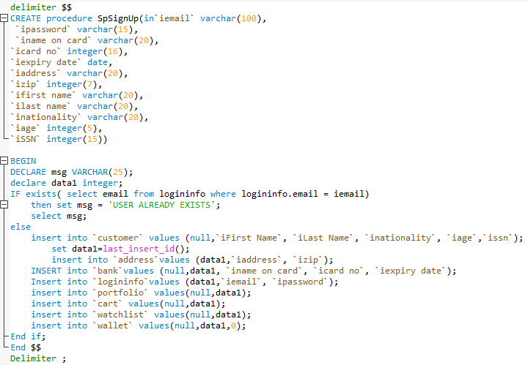
Fundamental Stored Procedure
Stored Procedure for SIGNUP

Slide 9
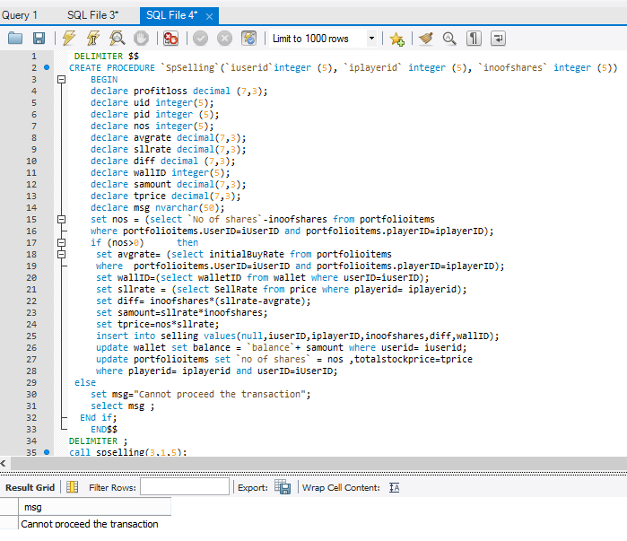
Stored Procedure for Selling

Slide 10
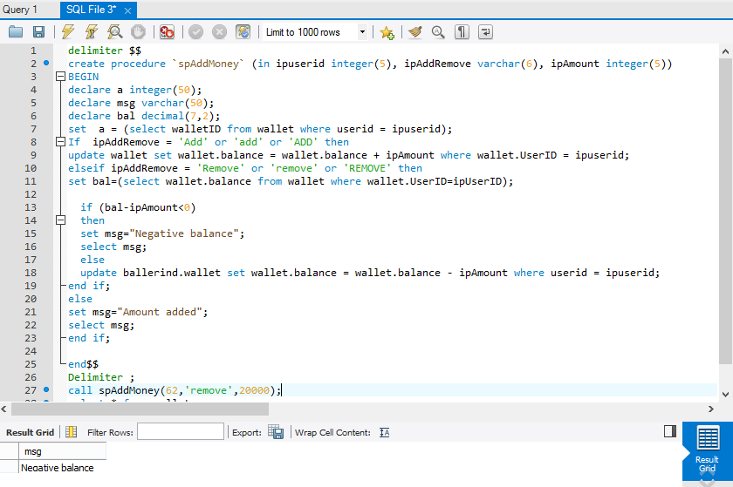
Stored Procedure to Add Money to Wallet

Slide 11
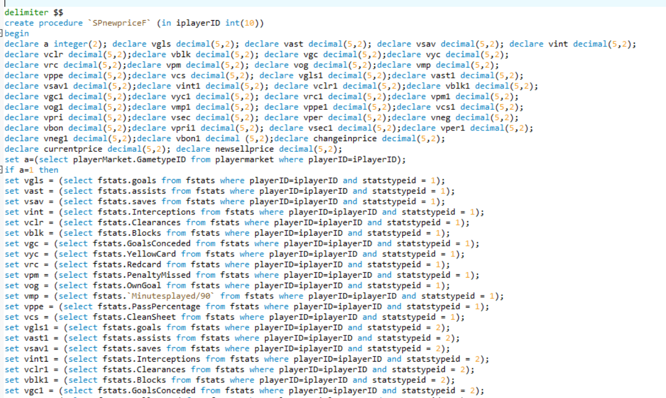
Stored Procedure to Update Price (Football)

Slide 12
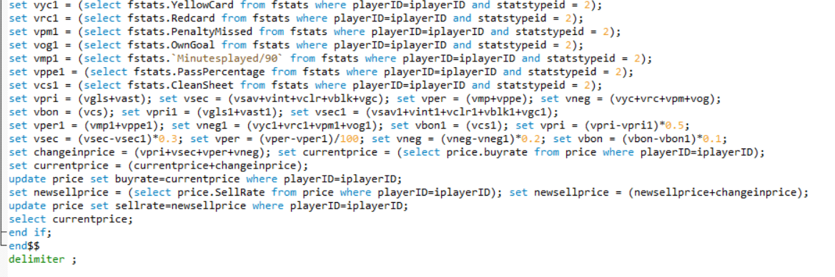
Continued

Slide 13
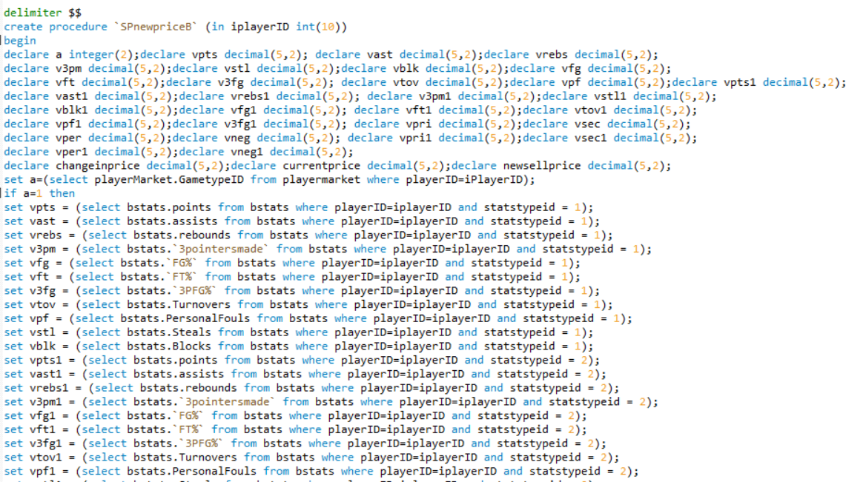
Stored Procedure to Update Price (Basketball)

Slide 14
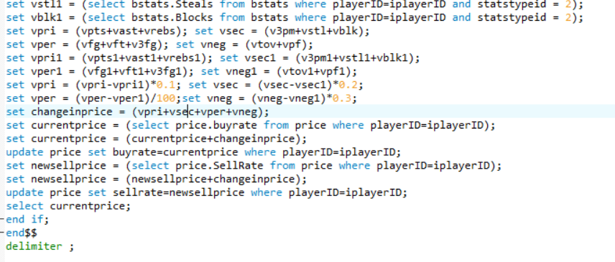
Continued

Slide 15
Backup
Number of hours full backup = 5
Number of hours incremental backup = 1
Number of hours full incremental backup = 3
Peak hours
during weekdays (3PM to 2AM)
During weekends (1PM to 2AM)
Backup Plan
Incremental backup – Monday , Tuesday , Wednesday (6-7AM)
Full Incremental backup – Thursday (6-9AM)
Full Backup – Monday(6-11AM)

Slide 16
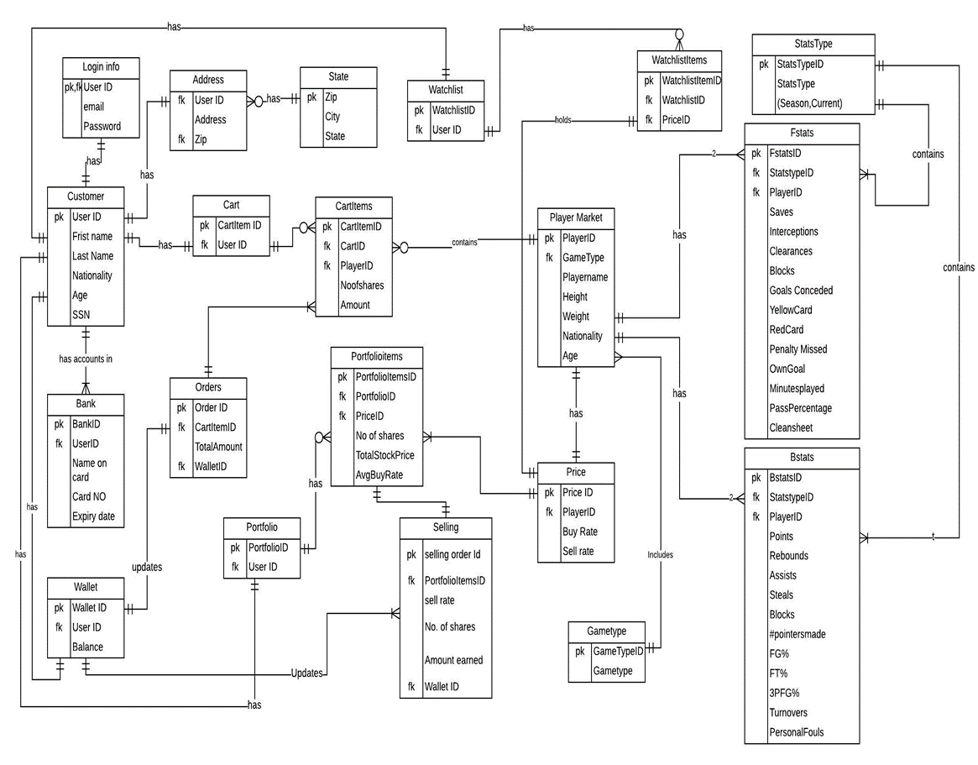
ENTITY RELATIONSHIP DIAGRAM

Slide 17
Assumptions and Constraints
Buyers and Sellers are available in the Baller Index
Stats factor taken into consideration only if the player plays the game
Initial shares floated in the market is 100000
Initial price of the player is decided by the player rater (Top 10 = $10, Top 11-20 = $7, rest of the players = $5)
Offseason the market will not be affected by stats, but by simple supply/demand
The customer market is based only in the United States having a valid Social Security Number
Limit of bank account of every individual customer will be 1
A customer can open multiple user account with different email id.

Slide 18
Players Analyzed
Soccer
Kaka
Sebastian Giovinco
Gyasi Zardes
David Villa
Tim Howard
Basketball
James Harden
Anthony Davis
Paul George
Blake Griffin

Slide 19
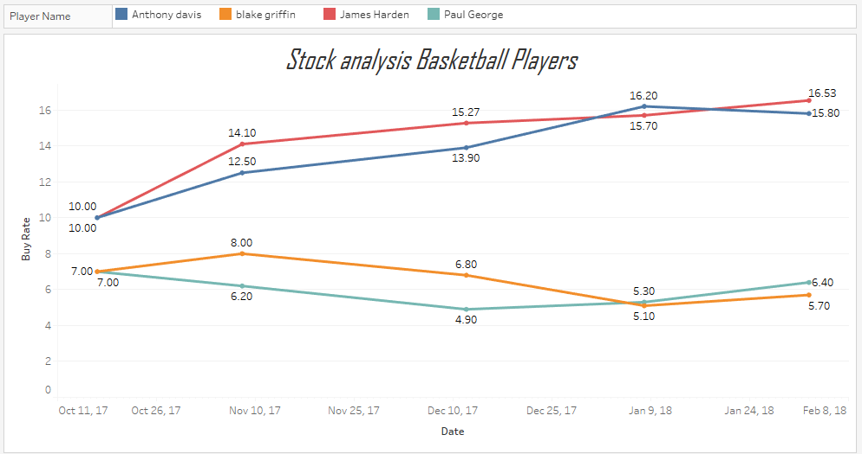
Stock Analysis

Slide 20
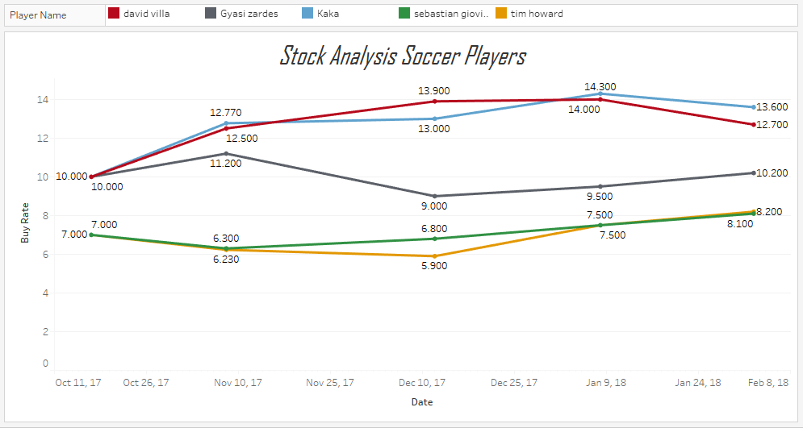

Slide 21
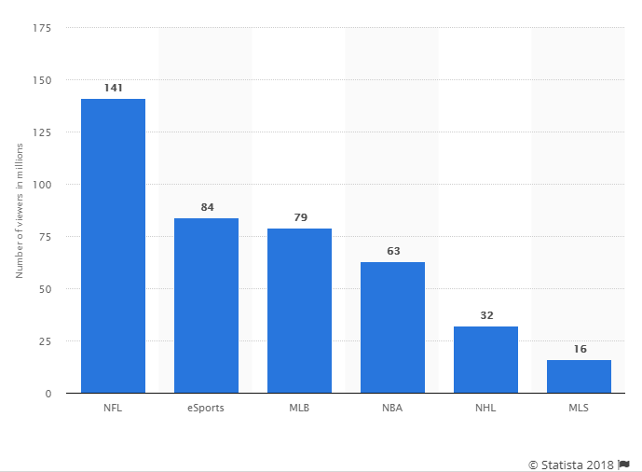
Future Scope
Currently the Baller Index consist of two sports:
Major League Soccer
National Basketball Association
The above mentioned sport captures only 20% of the total viewership. The business of the Baller Index can be further expanded by including major leagues. This will exponentially increase the customer base.
If a success, we could expand to different countries and other major sports.

Slide 22
References
http://www.nba.com/players/stephen/curry/201939
https://www.basketball-reference.com/
http://www.rotoworld.com/sports/nba/basketball?ls=roto:nba:gnav
www.google.com
www.statista.com
www.stackflow.com

